Slide 1
Local Corners MVP
Nick Huff

Slide 2
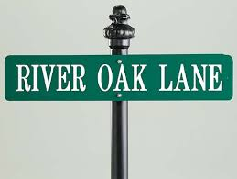
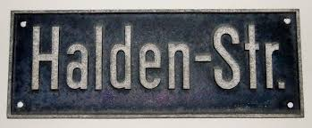


Events Parkway
The Simple and most cost effective way to market your works.
Helping the local customer find the local gems
Refinished Row
Taking the customer out of the Big Box, Chain stores and guiding them to your art
We help your unknown customers find your unknown works
Handmade Str.
We are the local search engine for locals
We uncover your art by finding your local customer

Slide 3
Answer these Questions
Have you tried posting on Craigslist but were not very successful
Have you taken a stab at blogging
Do you have a Facebook, Pinterest, or Instagram account but your success is marginal
What about building your own site but its never found?
I’ve done it all
DIYer’s and many small companies to do not have the luxury to hire a search party to find local customers.
We are your solution because we connect local customer to local business through Local Corners.
We take the fragmentation of so many types of advertising and bring it all together for you
Click on the local corner you are interested in and enter a zipcode

Slide 4
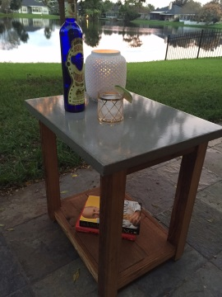
A customer in Jacksonville goes to Google and enters: Furniture 32246. With our Search Engine Optimization, Search Engine Marketing, Ad words etc. Local Corners comes up as a the top 10 hit
The customer Selects our site. Wala Echo at the Beach comes up. But not just once!!! At minimum 200 times !!!
Local Corners Becomes your Website.
Because we can use your credentials from Facebook and Pinterest we can upload the pictures and descriptions. Now Echo at the Beach is on the internet 600 times!!!
You upload your picture and enter a description:
Modern Cement top, reclaimed wood
Price Range 200-250
=
The Keywords from the description ties the search results to Echo at the Beach
Enter your Zipcode
Enter your store Front
Echo at the Beach

Slide 5
Events Parkway
The Simple and most cost effective way to market your works.
Helping the local customer find the local gems
Refinished Row
Taking the customer out of the Big Box, Chain stores and guiding them to your art
We help your unknown customers find your unknown works
Handmade Str.
We are the local search engine for locals
We uncover your art by finding your local customer

Slide 6
Enter Description
Enter Description
Start Dragging your images of your works into the boxes
2. Type in your Descriptions
3. Enter a Pricing range
4. Enter your contact info
Enter Description
Enter Description
Customer selects store front or event and an info box will appear for them to enter it in.
Name
zipcode
Email Address
How can people see your art?
Store Front Event Other

